Slide 1

DevOps Project: End-to-End Deployment of Todo Application using Docker, Kubernetes, CI/CD, and Monitoring
Project by :
Astha Bhende 240344223042

Slide 2
Introduction :
This project demonstrates an end-to-end DevOps pipeline setup covering:
- Containerization with Docker
- Orchestration using Kubernetes
- CI/CD automation with GitHub Actions & ArgoCD
- Monitoring and alerting with Prometheus & Grafana

Slide 3
Objective :
1. Containerize the Todo app using Docker
2. Orchestrate containers with Kubernetes
3. Implement CI/CD pipeline
4. Ensure persistent storage (PV & PVC)
5. Monitor infrastructure and applications

Slide 4
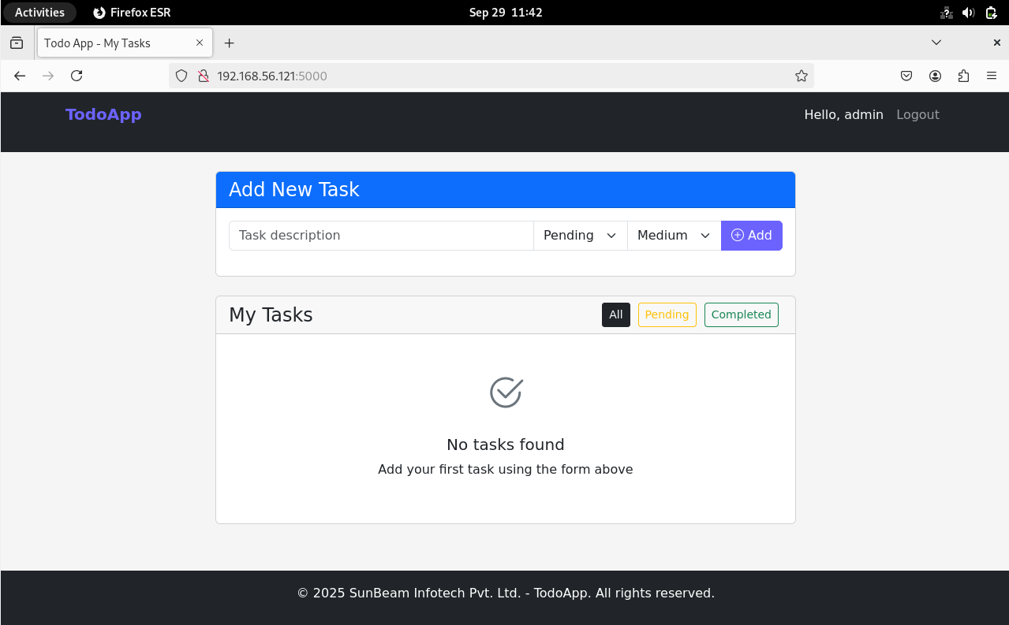
Day 01: Docker Setup
Configured Docker and containerized the Todo app.

Slide 5
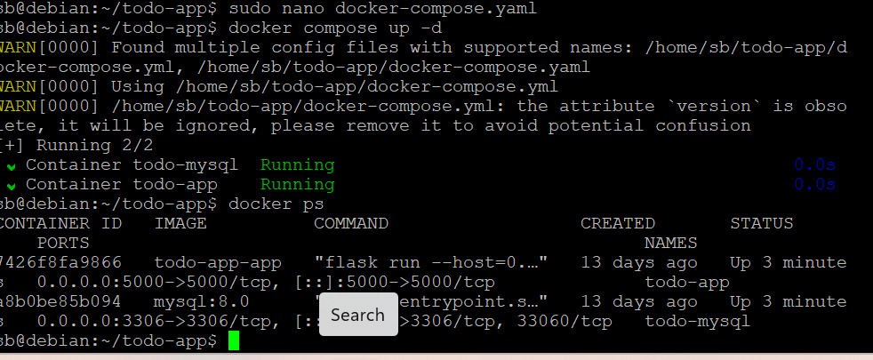

Slide 6
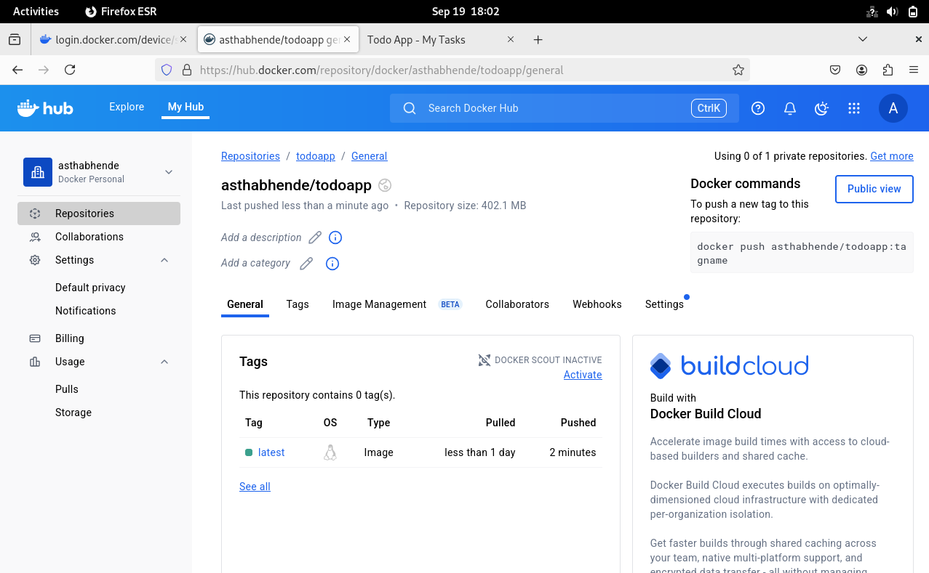

Slide 7
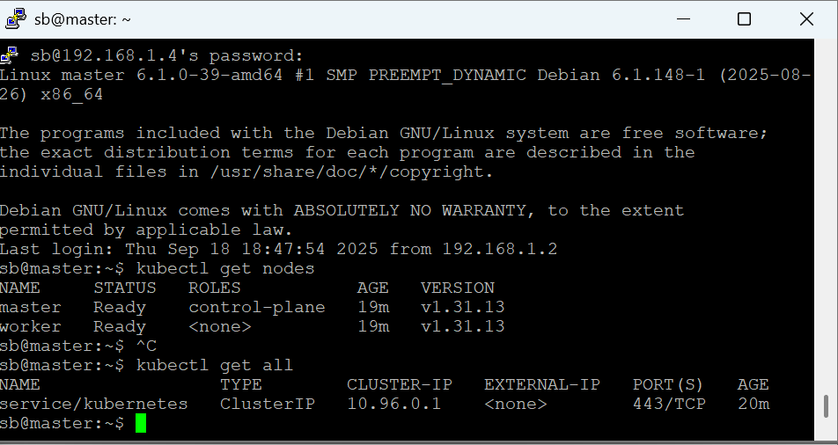
Day 02: Kubernetes Cluster
Created two VM nodes and set up a Kubernetes cluster.
Output: kubectl get nodes displaying master and worker.

Slide 8
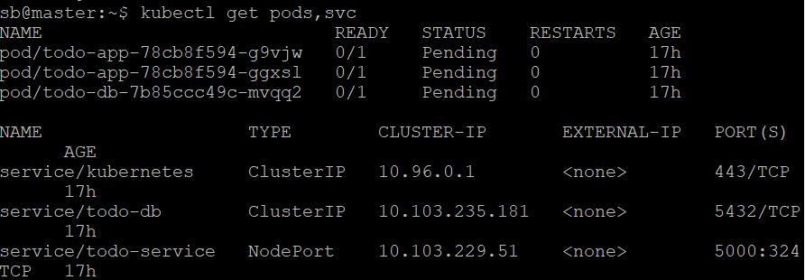
Day 03: App Orchestration
Deployed Todo app and DB pods with Kubernetes.
Output: kubectl get pods & services.

Slide 9
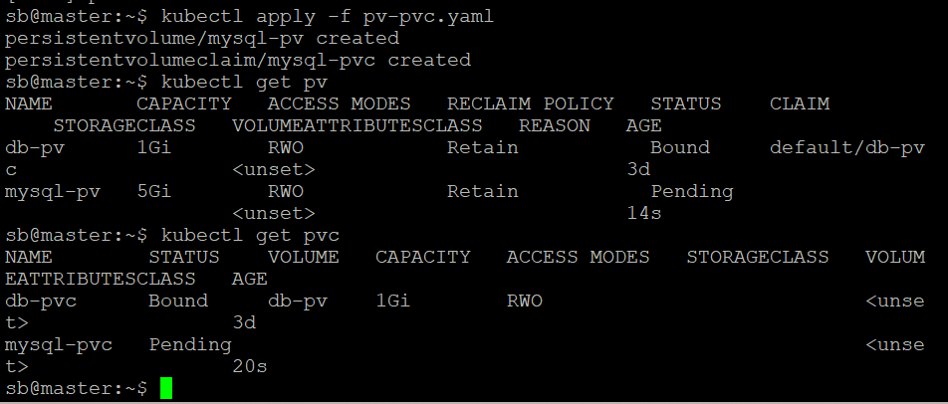
Day 04: Persistence & CI/CD
Configured PV/PVC and GitHub Actions + ArgoCD.
Output: PV bound, ArgoCD UI showing synced app.

Slide 10
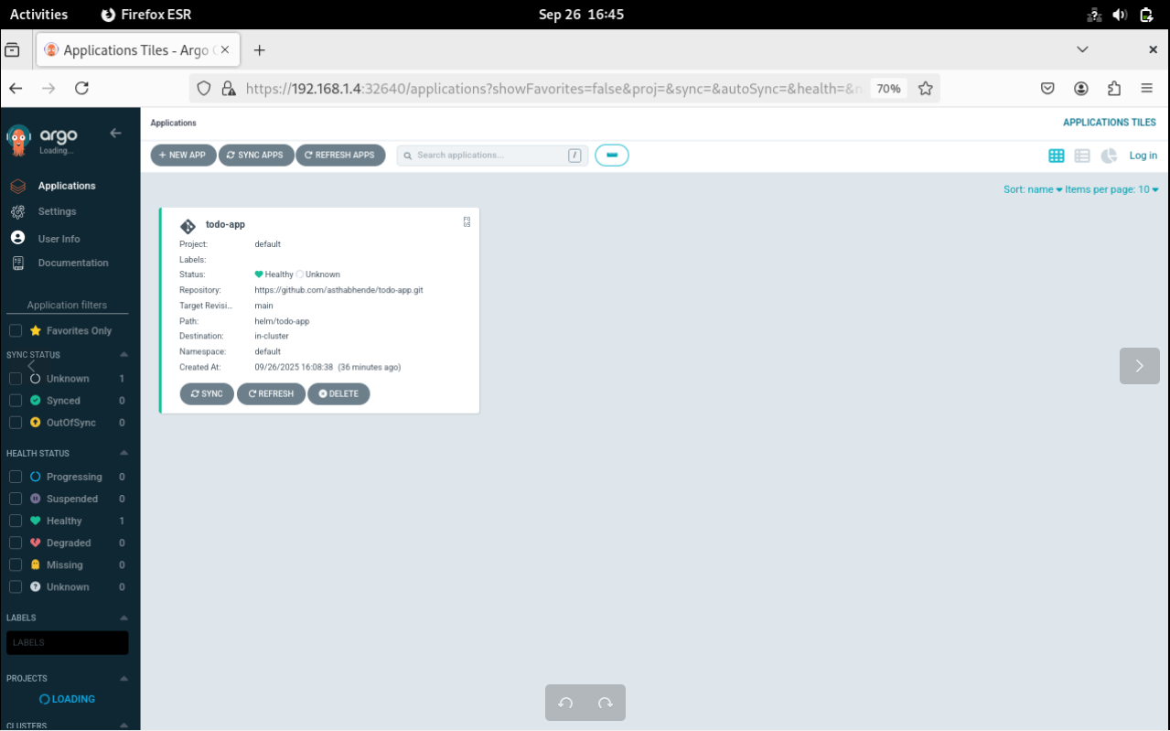

Slide 11
Day 05: Monitoring
Set up Prometheus & Grafana dashboards.
Output: Metrics visible in Grafana dashboards

Slide 12
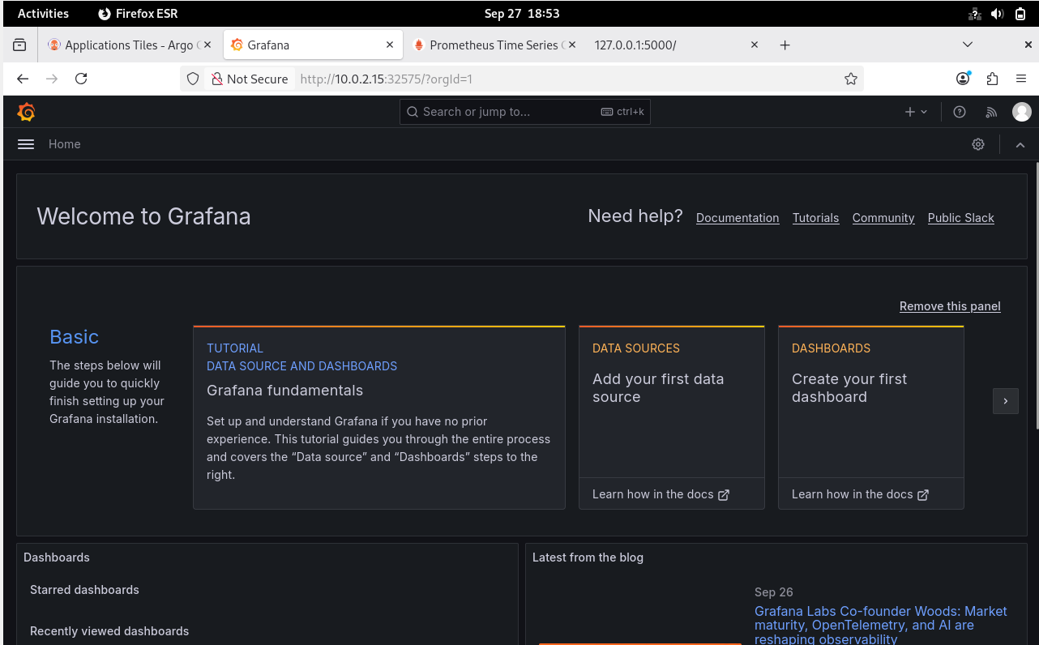

Slide 13
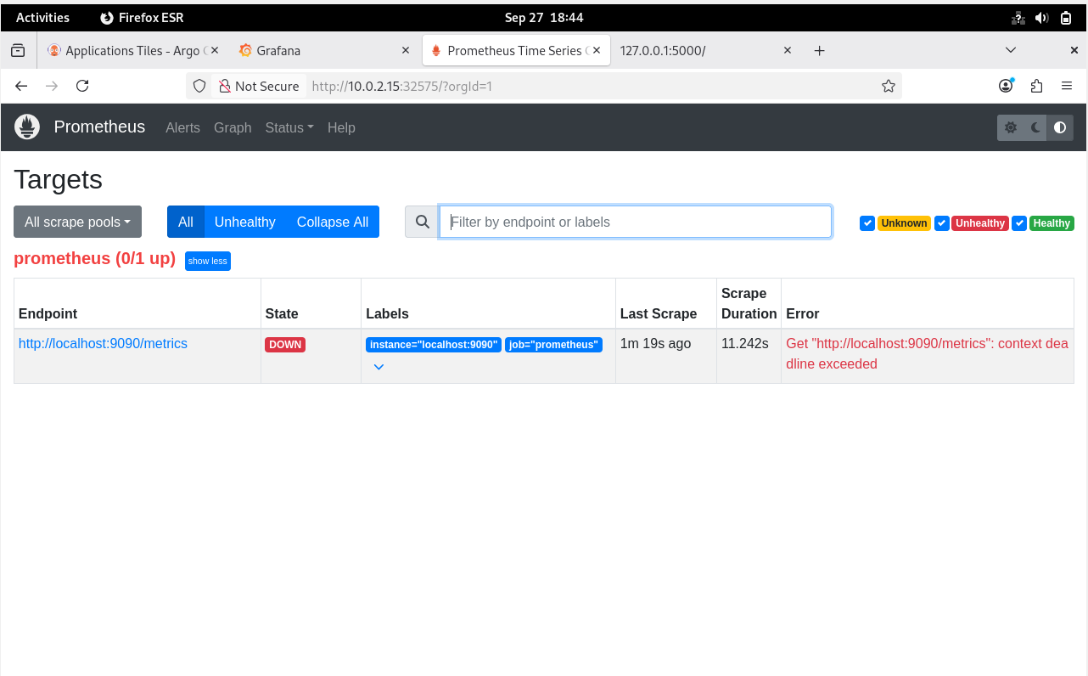

Slide 14
Network Architecture :
VM 1: Kubernetes Master Node
VM 2: Kubernetes Worker Node
Database Pod + Application Pod connected through Kubernetes Service
Prometheus & Grafana running inside the same cluster for monitoring
GitHub + ArgoCD integrated with cluster for CI/CD

Slide 15
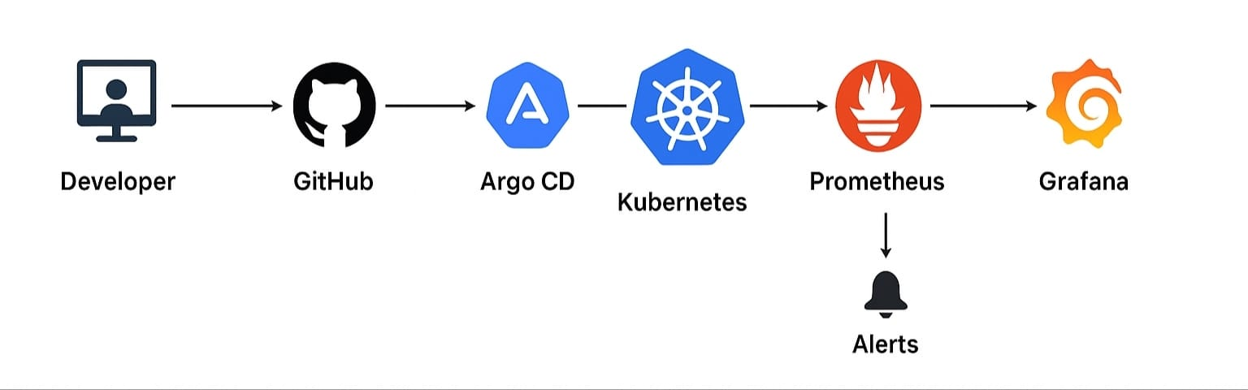
Architecture :

Slide 16
System Architecture
1.Docker: Containerization of Todo App + Database
2.Kubernetes: Deployment & Service to orchestrate app
3.Persistent Volumes: Data storage for DB
4.CI/CD:
CI: GitHub Actions (build, test, push image)
CD: ArgoCD (auto-deploy to cluster)
5.Monitoring:
Prometheus collects metrics
Grafana visualizes & alerts

Slide 17
Tools Used
Docker 🐳 – Containerization of application & DB
Kubernetes ☸️ – Orchestration of containers across VMs
GitHub Actions – Continuous Integration (build/test pipeline)
ArgoCD – Continuous Deployment (GitOps-based deployment to K8s)
Helm – Packaging Kubernetes manifests into reusable charts
Prometheus 📊 – Metrics collection for infra & app
Grafana 📈 – Dashboards & alerting system

Slide 18
Outcomes & Impact :
• Automated deployments with CI/CD
• Scalable and resilient infrastructure
• Persistent data storage for the app
• Centralized monitoring & proactive alerting
• Complete production-ready DevOps pipeline

Slide 19
Thank You

